Slide 1
Import data from
text and csv
Import data from
text and csv

Slide 2
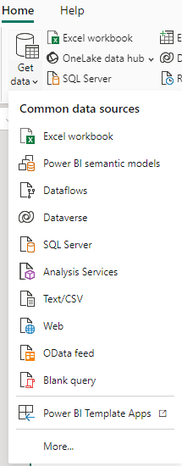
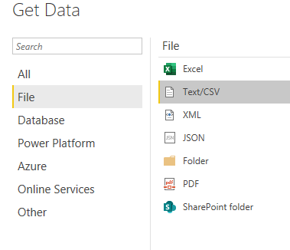
Importing text and CSV data
Note: This Lab uses the csv files found at \resources\ CSVSource
Choose data source from More… menu
2
1

Slide 3
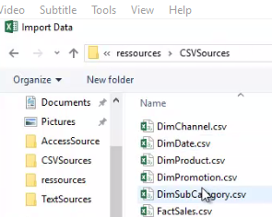
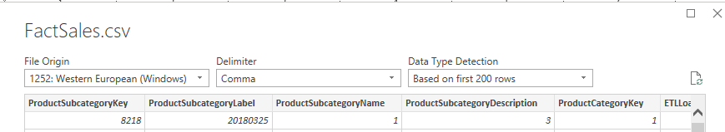
Importing text and CSV data
Navigate to the folder that contains the csv files, select FactSales.csv and click Load
1: The Unicode
2: The column separator used at the CSV file level
3: Choose to load the first 200 rows or all data
Notice the three fields at the top
1
2
3

Slide 4
Importing text and CSV data
Also notice the buttons that are at the bottom
4
5
6
4: Load data immediately into Power BI
5: Switch to Power Query Editor before loading the data to transform it first
6: Cancel import
Repeat the same procedure with the rest of the csv files
Select the Model menu on the far left and notice that there is no link between the imported tables unlike in the previous Lab

Slide 5
Thank you
Thank you

